Slide 1
MyUH Services
Chase Kawakami, IT Specialist, chasek@hawaii.edu
Jeela Ongley, Content Specialist, ongley@hawaii.edu

Slide 2
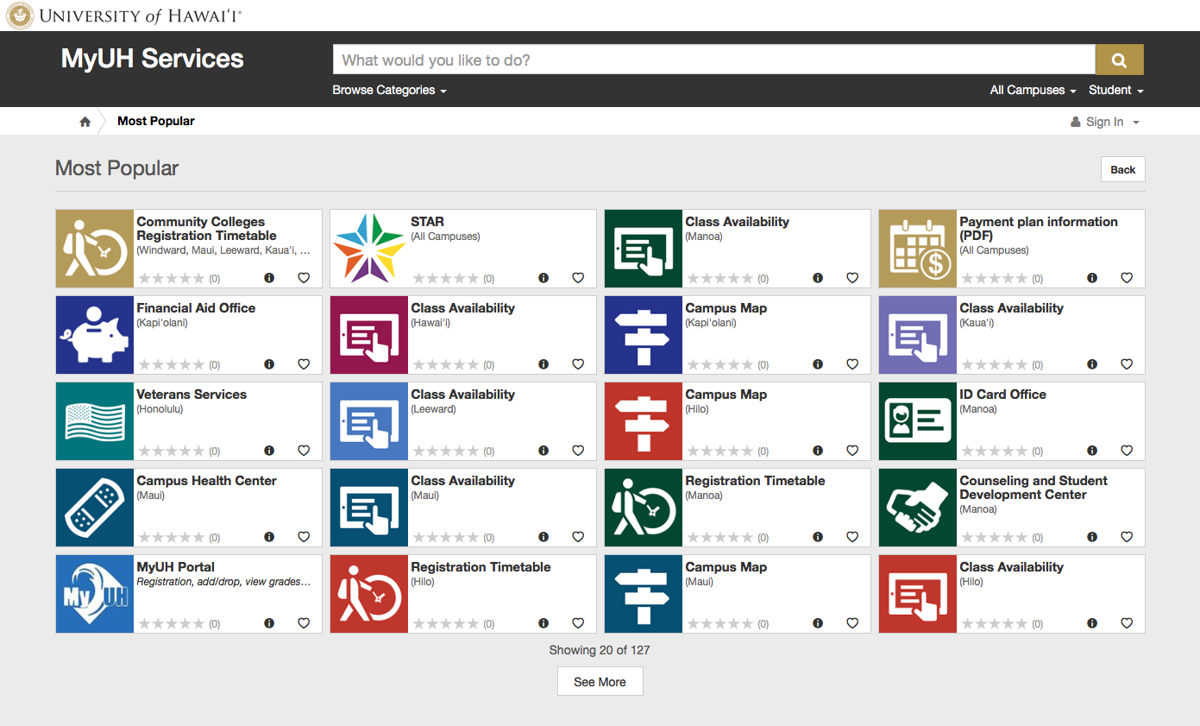
https://www.hawaii.edu/myuhservices
Mobile-optimized
Search driven
Directory of:
academic services
business tasks
forms
apps
and more...
For students, faculty & staff
10 campuses
Spring 2017
Check it out now:
http://myuh2.hawaii.edu

Slide 3
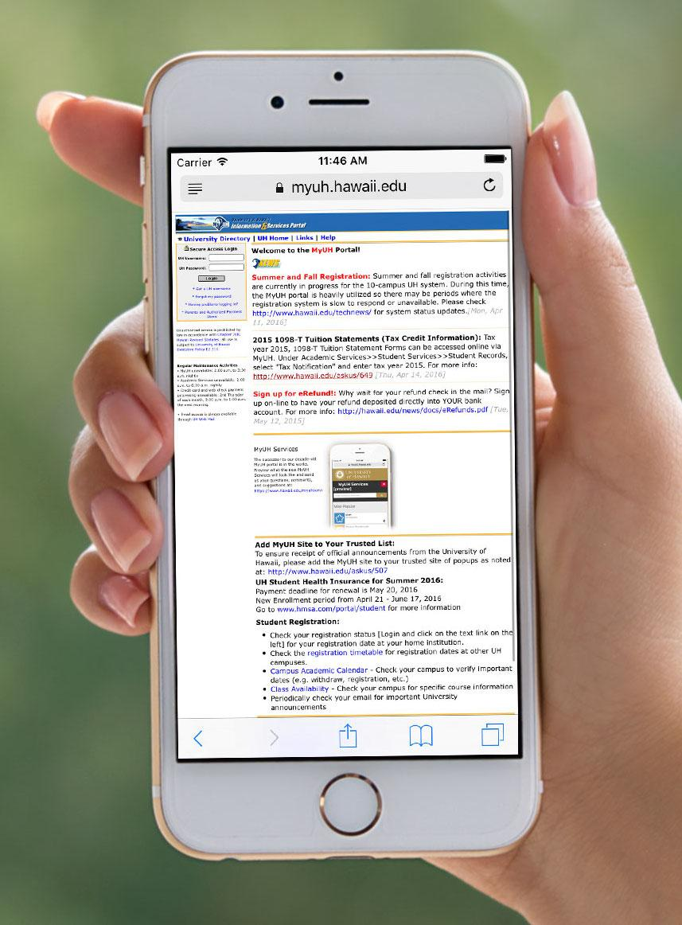
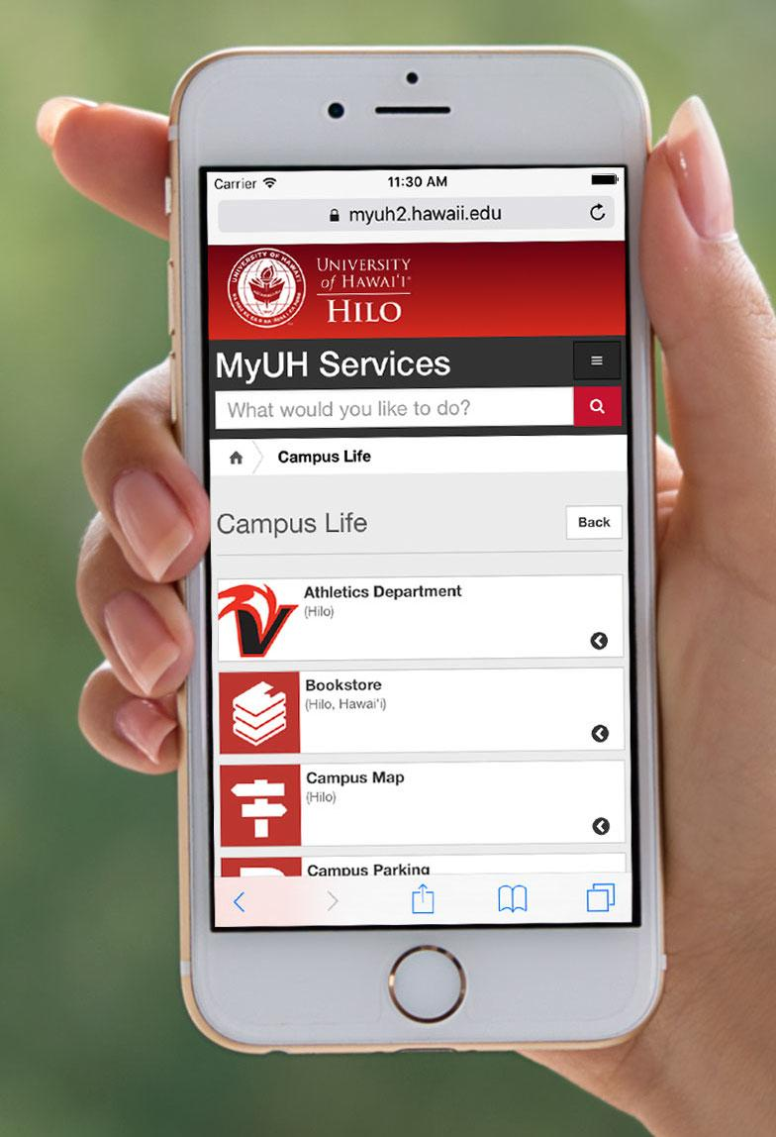
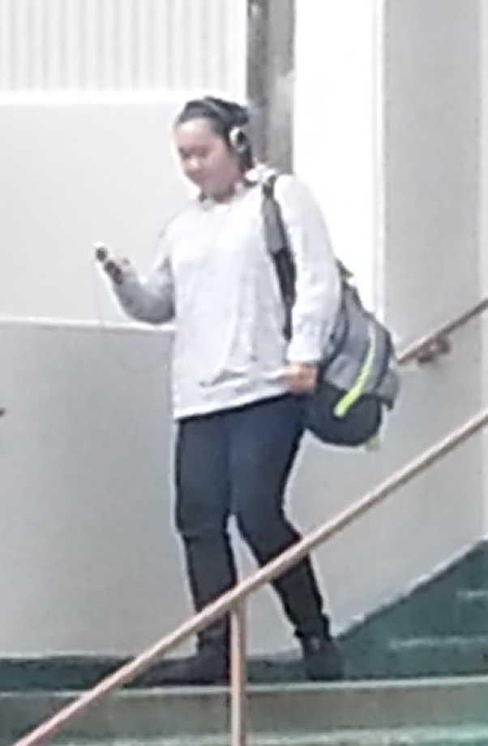
What would you rather see?
Say you’re walking down a steep flight of stairs on a rainy day, looking at your phone…

Slide 4
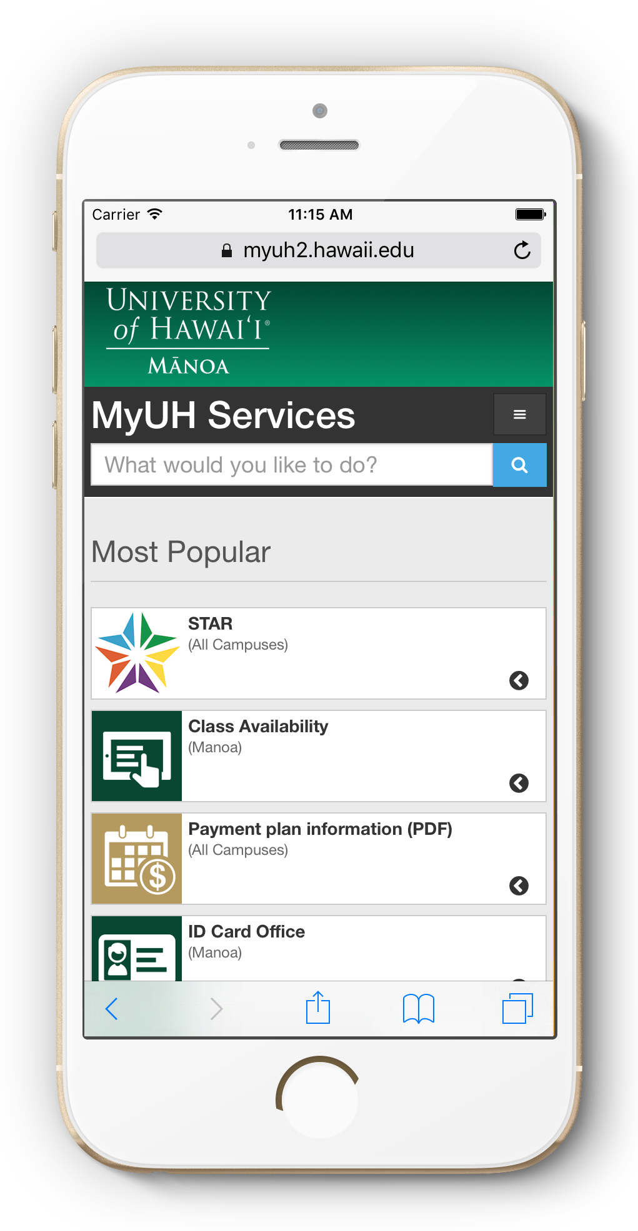
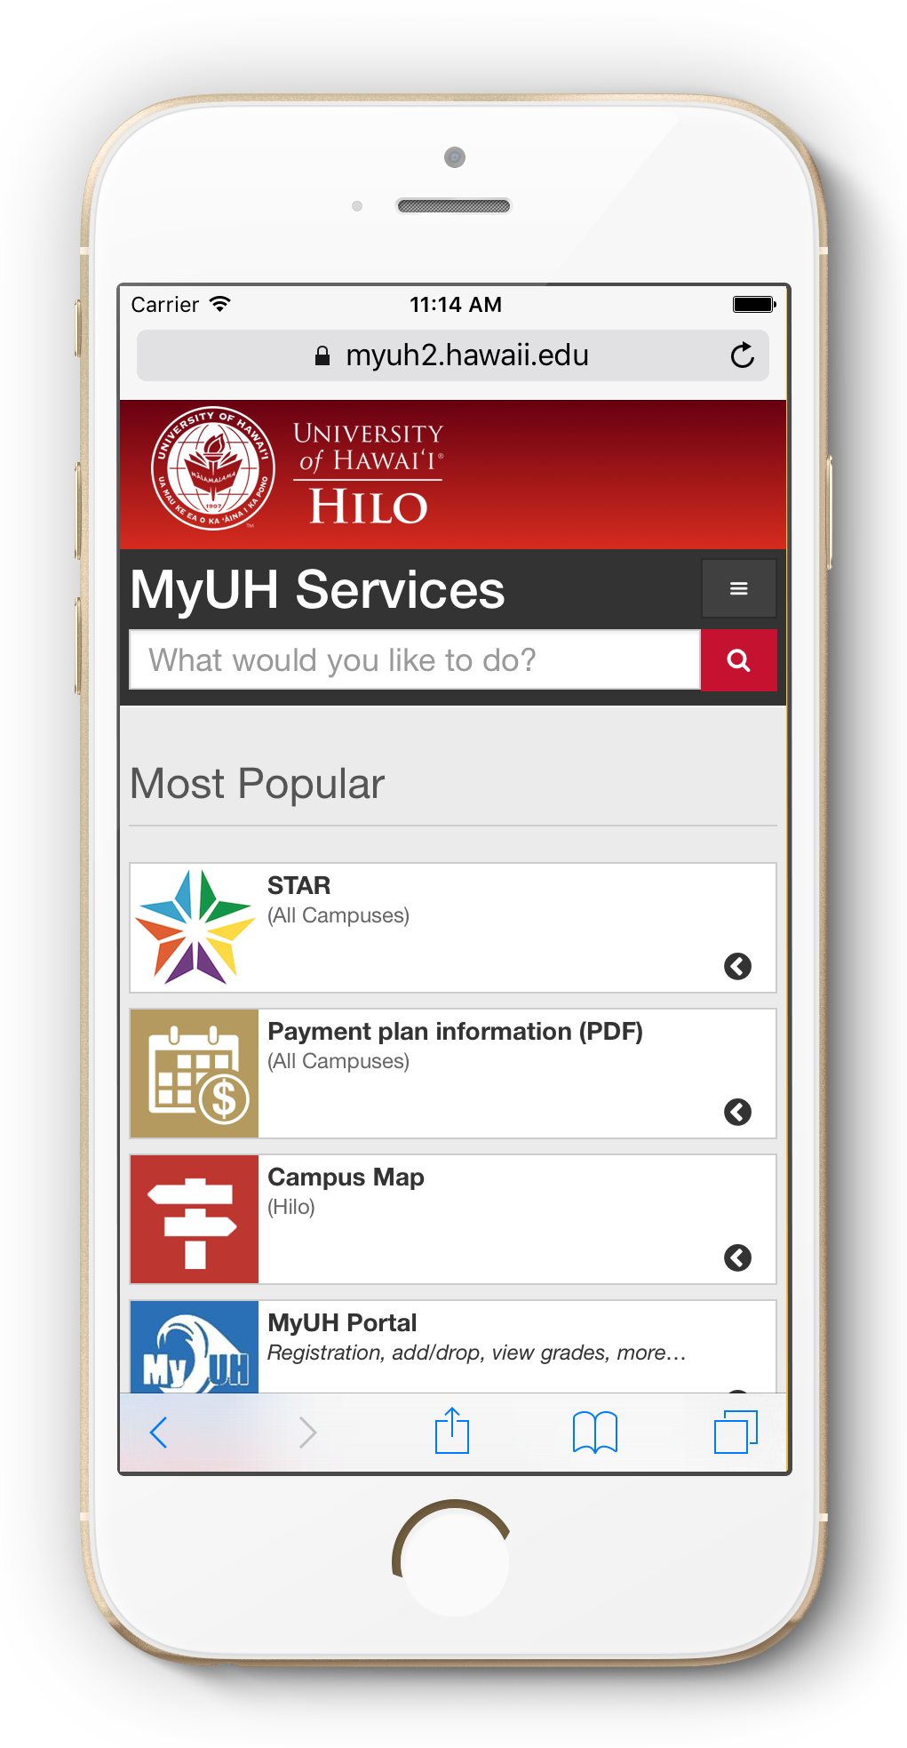
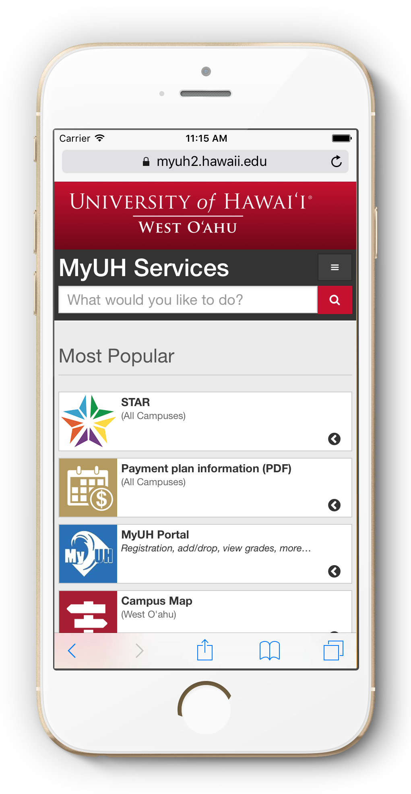
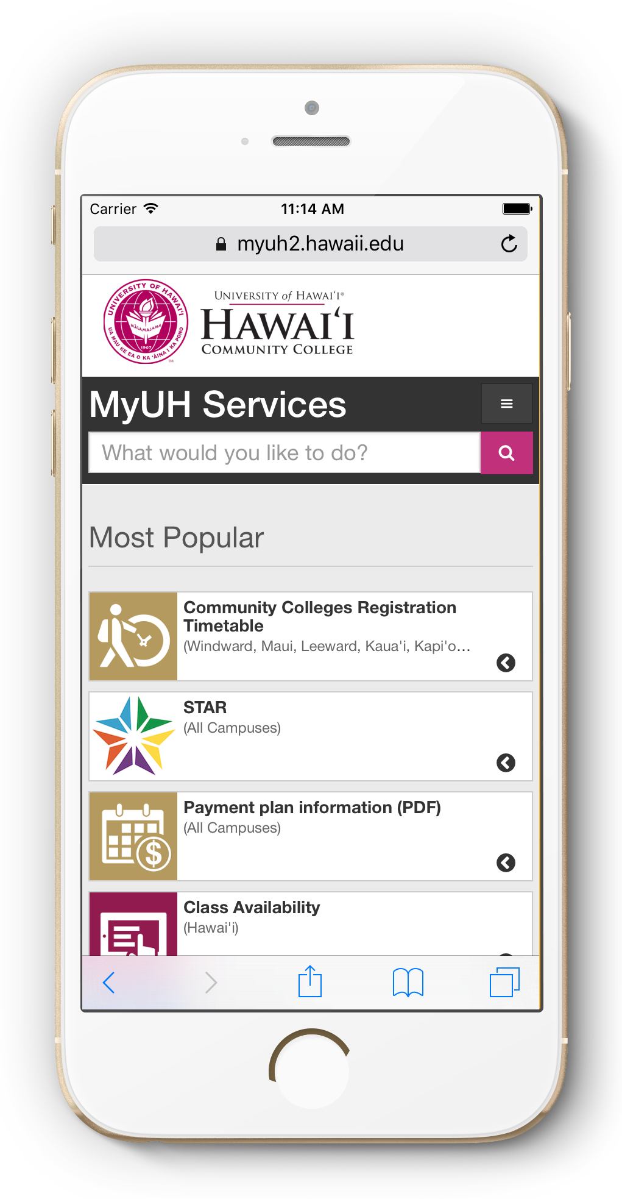
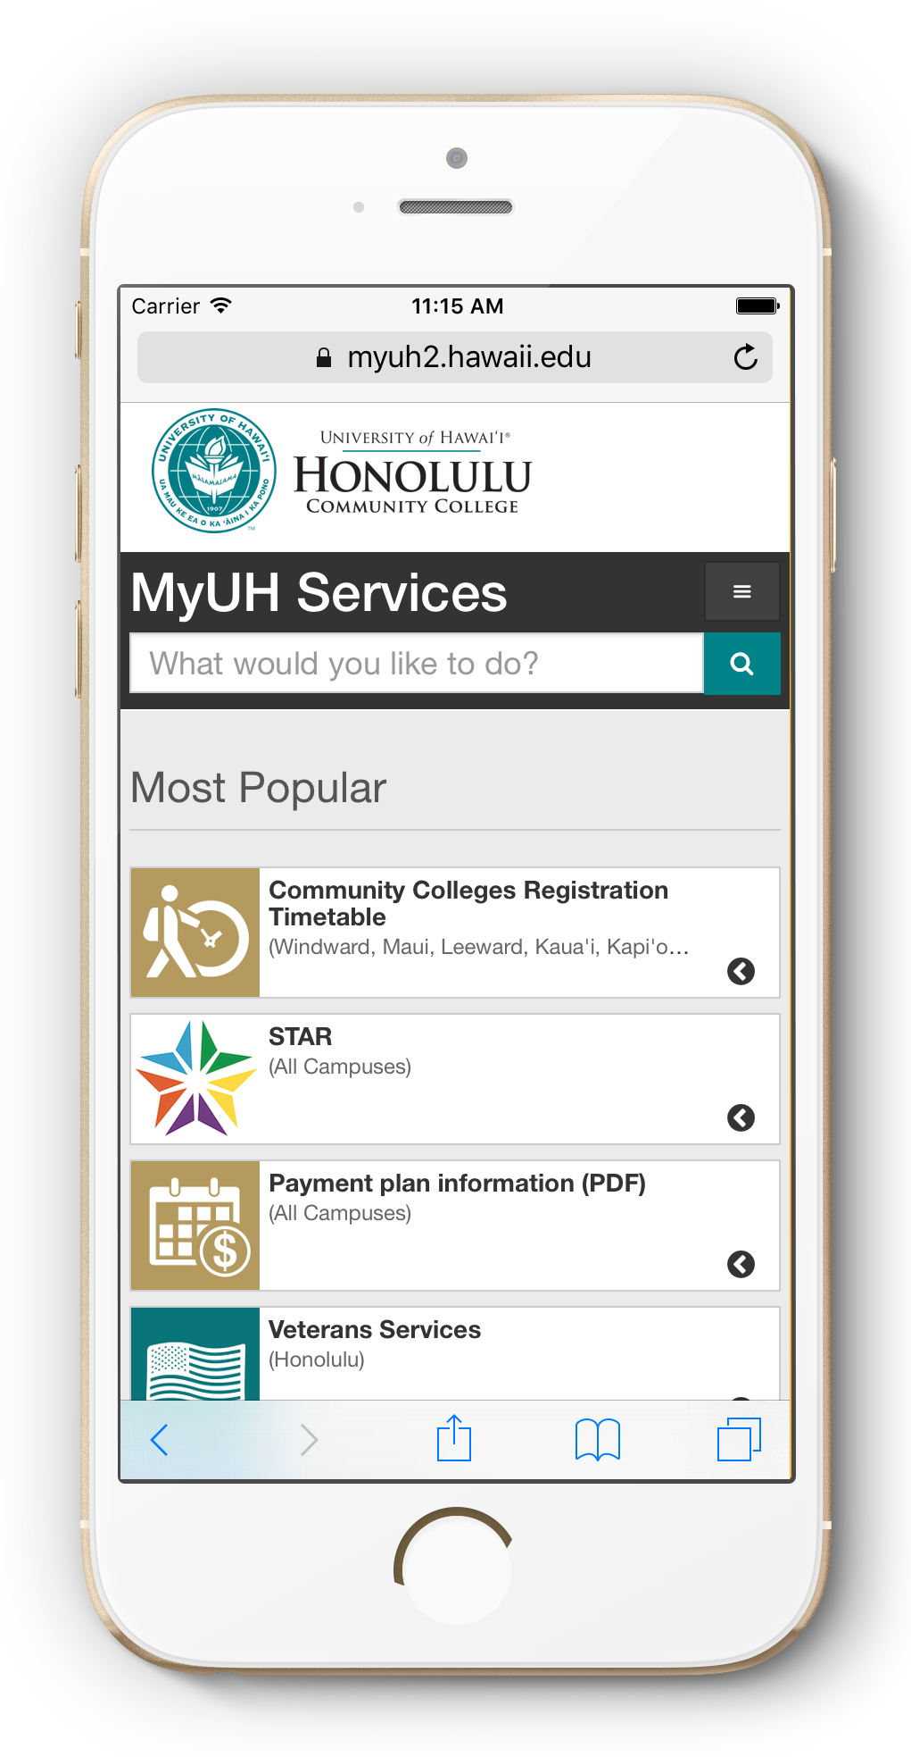
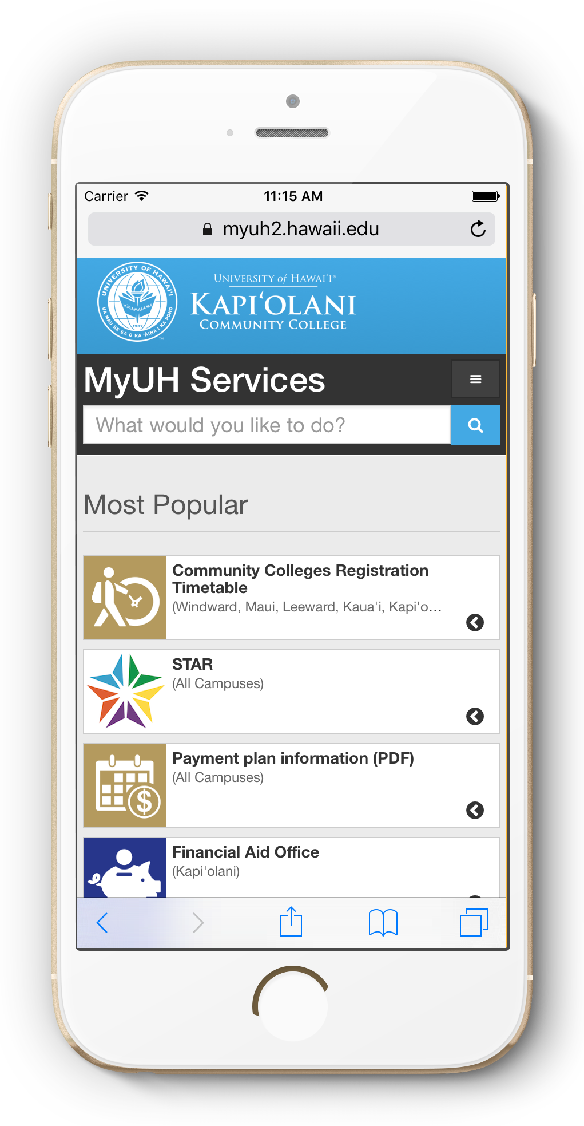
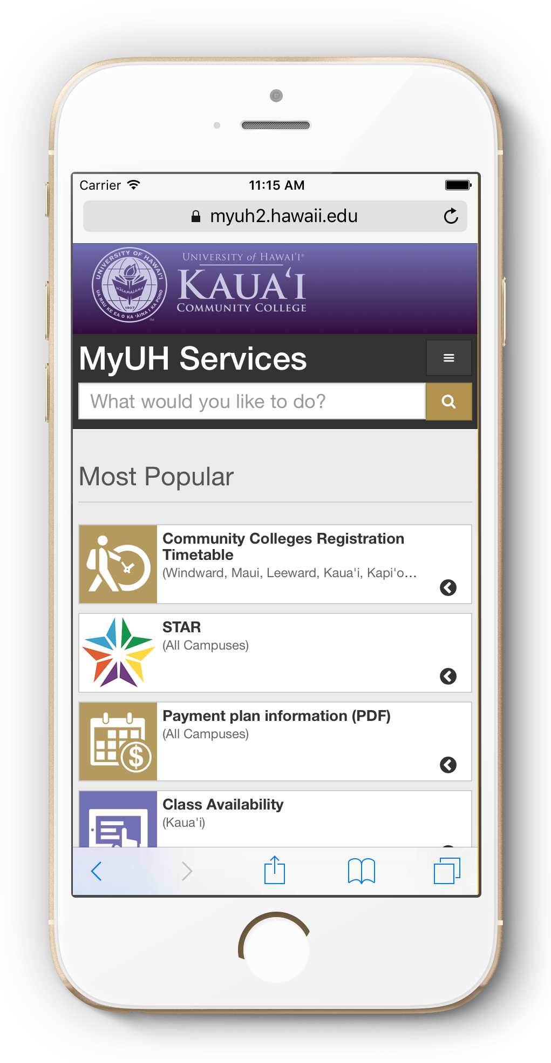
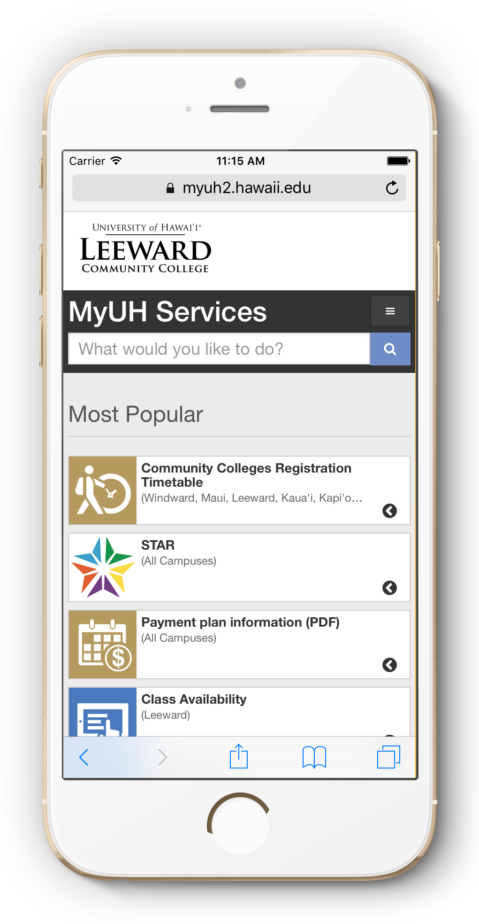
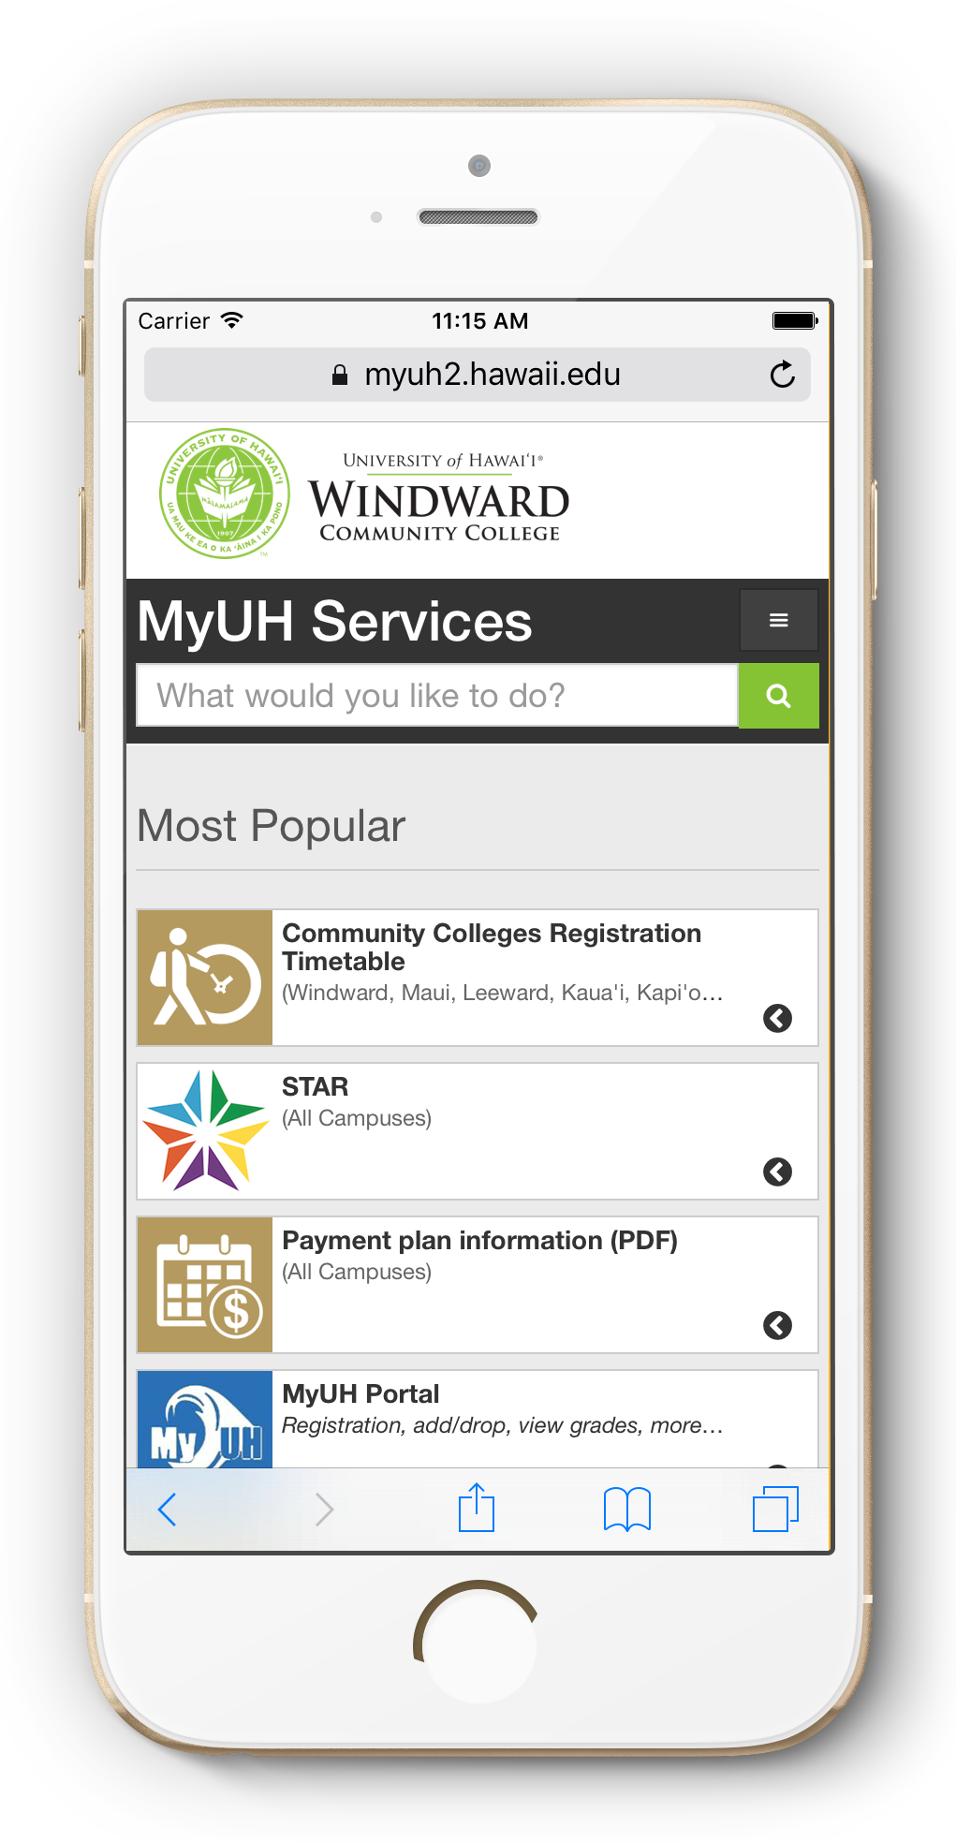
Campuses

Slide 5
What’s new?
Layout, analytics & accessibility improvements by rSmart
UH campus publishers being identified and distributed publishing systems established
Banner services coming soon
245 services
17 service groups
8 categories
...and counting!

Slide 6
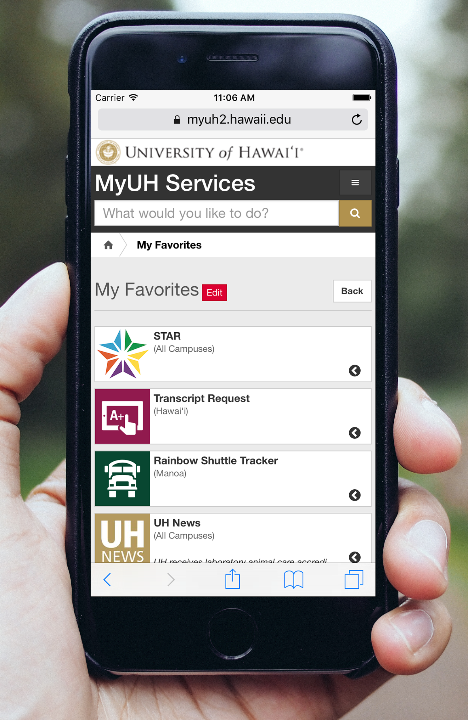
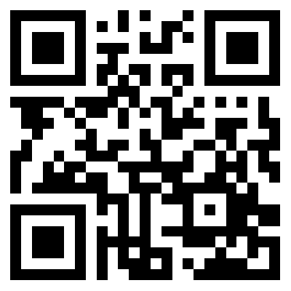
Feedback please!
https://www.hawaii.edu/myuhservices
Search for your commonly used services
Login with UH username
Set preferences and select/edit favorites
Take the (very short) survey! http://go.hawaii.edu/0Gj
Survey QR code

